Slide 1
Job Search

Slide 2


Slide 3
The Three R’s of Searching for a Job
Researching Yourself
Researching the Company
Research the Position

Slide 4
The Three R’s of Searching for a Job
What are your skills, attributes, and accomplishments?
What can you bring to the company that is unique?
How do your qualifications meet the position’s requirements?
What interests you about this company and the position?
What is the employer’s product or service?
What is the company’s vision or mission statement?
What are the needs or problems of the employer?
What role does the employer play in the community?
Is the employer expanding?
What are the job responsibilities?
What are the pay and benefits for this job?
What skills and talents are needed for the position?
What is the growth opportunity for this field?

Slide 5


Slide 6
Establishing your professional Brand
You are always looking for opportunities or possibilities as a professional so knowing how to put yourself out there while seeking a job

Slide 7
1.
Professional Brand
What is it and how to develop it?

Slide 8
To present your professional or otherwise known as personal branding, you need to understand what employers are looking for, and then need to craft the materials that will present the brand to the world.

Slide 9
Understanding what Employers want
Honest
Hard working
Technically competent
Skilled at problem solving
Team and individual worker
Having an S curve for learning

Slide 10
Building the Foundation of your Professional Brand
Research what others have done
Tell the truth
Communicate professionally
Describe your job skills
Focus on problem-solving and accomplishments

Slide 11
Crafting Your Professional Brand
Create a strong online presence
Your own website
Try Weebly or Squarespace or free blogging site such as Wordpress
Participate on LinkedIn
Social media used specifically by professionals
Include keywords for appearing in searches
Participate on Facebook
Create pages for specific interests
List specific skills in skills section
Link good videos and resources for others to see; participate in discussion. Make yourself visible
Make them public

Slide 12
Crafting Your Professional Brand
Participate on Twitter
Follow influential people
Create a business card
Practice an elevator pitch
Follow events conferences and publications of interest
Direct people to your socials
Have your contact information listed
Brief oral summary of your credentials
Less than 20 seconds long

Slide 13
How to Create a Profile on Linkedin
Enhance your Headline
Full name, job responsibility and company name
Add a photo
Make sure it’s a portrait and professional
Summarize and sell
Primary industry, key areas of interest, highlight your experiences
Detail your work experience
Dates of employment, names of companies, detailed listings of jobs and achievements
Provide keywords and skills
Include keywords
Add keywords to your Linkedin site
Link your socials (website, blog, email, Twitter etc.)
Get recommendations
Quantifies your value

Slide 14
https://youtu.be/0a0Vm0zHFh0 [Personal Branding- Why is it important?]
https://youtu.be/Alqt7pIbp_o [Designing a purposeful personal brand from zero to infinity | Tai Tran | TEDxBerkeley]
https://youtu.be/pyLXbLdR75s [How to Find A Job Online 5 min]
https://youtu.be/BQ2_BwqcFsc [Here is a Ted talk from David Epstein, the author of “Range” where he talks about generalist vs. specialist debate]

Slide 15
2.
Looking for a job

Slide 16
Finding the Right Position
Do a self inventory
Learn about potential employers

Slide 17
Do a Self Inventory
What are your strengths and weaknesses?
What subjects do you like?
What kind of organizations would you like to work for?
What are your geographical preferences?

Slide 18
Learn about Potential Employers
Look up articles and on portals find their interviewing styles and strategies
Find out more trends in your field
Attend job fairs
Prepare a resume and a job application letter
Put your portfolio items online

Slide 19
3.
Resumes and CV’s

Slide 20
Curriculum Vitae / Resume
Document highlighting
Qualifications
Experience
Awards
Skills of an applicant

Slide 21







Curriculum Vitae (CV)
Fellowships
Research grants
Suitable for Academic Contexts
Long; 1-5 Pages
Complete run-through of ALL experiences and qualifications
Scholarships
Postgrad/Postdoc studies

Slide 22





Resume
Jobs
Short; 1-2 Pages
ONLY the most relevant experiences and qualifications
Suitable for Professional contexts
Internships

Slide 23
General Guidelines
Consistency
Font style
Layout
Format
Accessibility
Make sure the reader can easily find what they are looking for
Relevance
Maintain audience relevance; tailor CV/Resume according to requirements
Professionalism
Maintain professionalism in layout, language, style, and formatting
Concreteness
Provide concrete examples and evidence; don’t just list your achievements

Slide 24
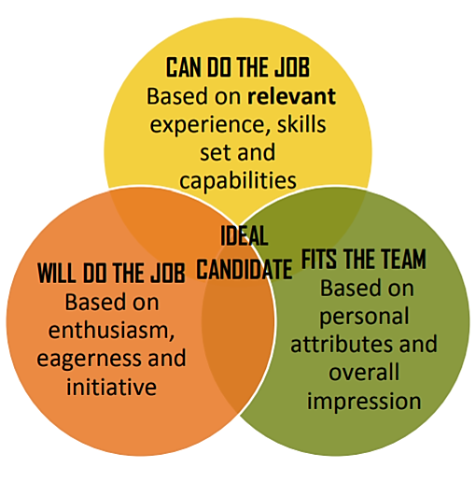
Evaluation Criteria for CVs/Resumes
Educational programs and employers want someone who:

Slide 25
Evaluation Criteria for CVs/Resumes
Readers will evaluate your…
Education, professional training, credentials, and certifications
Relevant professional experience including research
Ability to set and achieve goals and produce positive and if possible, measurable outcomes
Depth of knowledge and competency within your field

